Slide 1
NAAN MUDHALVAN
DATA SCIENCE FUDAMANETAL PROJECT
PROJECT TITLE:
EDA /ELECTRICITY PRODUCTION
PRESENTED BY:
  A.KARUPPU
  REG.NO: 912321105013
  SACS M.A.V.M.M. ENGINEERING COLLEGE
  III YEAR EEE DEPT

Slide 2
Project statement
The goal of this project is to focus on electricity production for energy analysts, policymakers, and researchers aiming to understand global energy trends, identify patterns, and develop strategies for sustainable energy production and consumption.

Slide 3
Problem solution
This dataset encompasses diverse parameters, including country-wise production figures, variations in energy sources, and production methodologies. Through Exploratory Data Analysis (EDA), we aim to uncover patterns, trends, and relationships within the data.
By Utilizing the pandas, numpy and visualization skills we can have valuable insights into global energy production patterns.

Slide 4
System approach
Building the proposed solution would involve a combination of data processing, python programming and visualization skills.
System requirements:
  Hardware :
      A computer with sufficient processing power, preferably with multiple cores or a GPU for faster training of machine learning models.
      Adequate RAM to handle the size of the dataset and computational requirements.
  Software:
      - An operating system compatible with the required python libraries (e.g., windows,linux,macOS).

Slide 5
System approach – Cont…
Library Requirements:
Data processing and analysis:
  Pandas : For data manipulation and analysis.
  Numpy : For numerical operations on data.
Data visualization:
  Matplotlib and seaborn: For creating visualizations to understand data patterns.

Slide 6
ALGORITHM & DEPLOYMENT
Algorithm selection
Data exploration :
This dataset encompasses diverse parameters, including country-wise production figures, variations in energy sources, and production methodologies.
Problem formulation:
Define the problem: Predict the Electricity production of different countries
Algorithm selection:
Importing Libraries
Dataset Description
Understanding the Dataset
information about the Dataset
Checking the Missing Value
Plotting Heatmap for Null Values

Slide 7
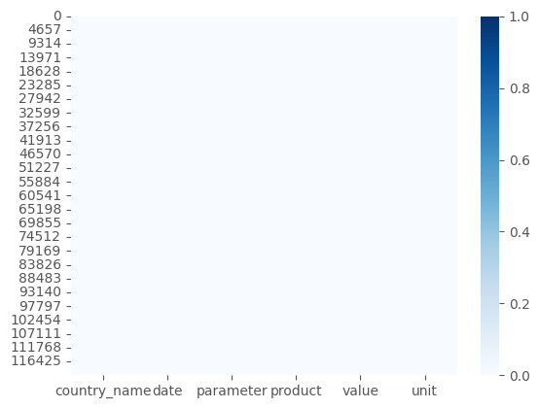
RESULTS

Slide 8
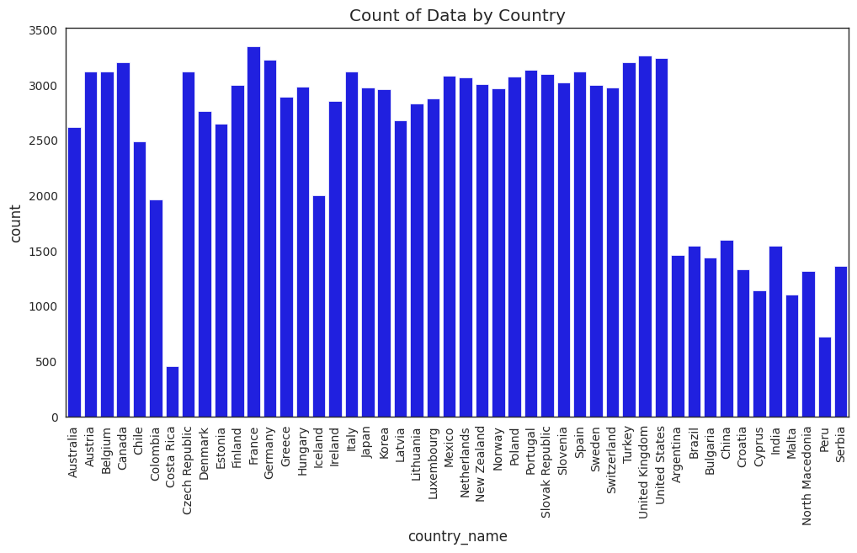

Slide 9
CONCLUSION
"EDA | Electricity Production“ exploratory data analysis skills are impressive, especially in analyzing electricity production data.

Slide 10
REFERENCES
http://www.kaggle.com/datasets
http://pandas.pydata.org/pandas-docs/stable/user guide/ index.html
http://seaborn.pydata.org/
http://matplotlib.org/stable/contents.html

Slide 11
THANK YOU

